Slide 1

E-Commerce Sales Analysis with Python
This presentation explores the results of an e-commerce sales analysis using Python. We'll examine the key insights and recommendations for optimizing sales and revenue growth.
sn
By Soumya ranjan nayak

Slide 2
Project Breakdown
1
1. Data Gathering
2
2. Data Preparation
3
3. Visualization
.
4
4. Insights
5
5. Recommendations

Slide 3
Business Requirements
Calculate the monthly sales of the store and identify which month had the highest sales and which month had the lowest sales
1
2
Analyze sales based on product categories and determine which category has the lowest sales and which category has the highest sales
The sales analysis needs to be done based on sub-categories
3
Analyze the monthly profit from sales and determine which month had the highest profit
4
Analyze the profit by category and sub-category
5
6
Analyze the sales and profit by customer segment
Analyze the sales to profit ratio
7

Slide 4
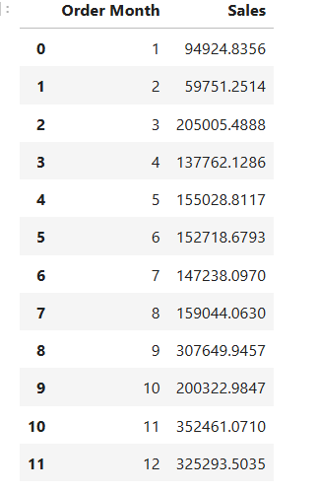
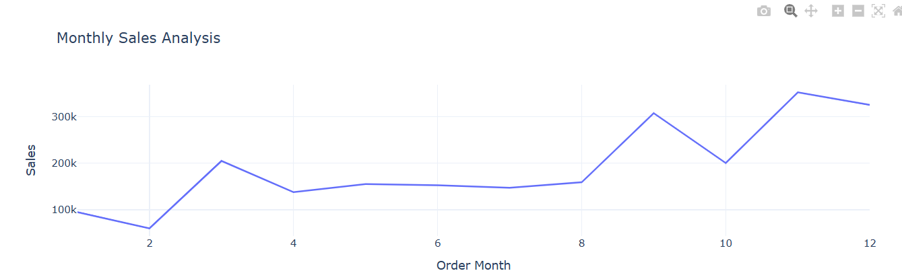
Q1. Monthly Sales Analysis

Slide 5
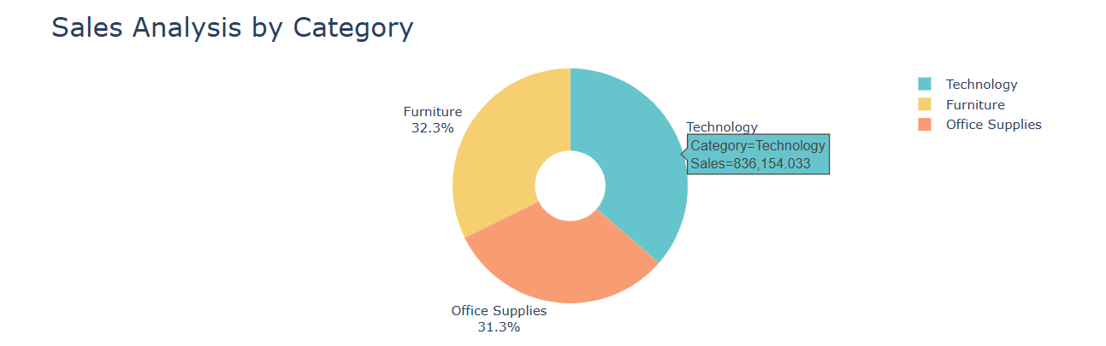
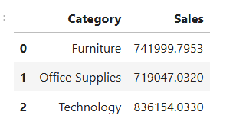
Q2. Sales Analysis by Category

Slide 6
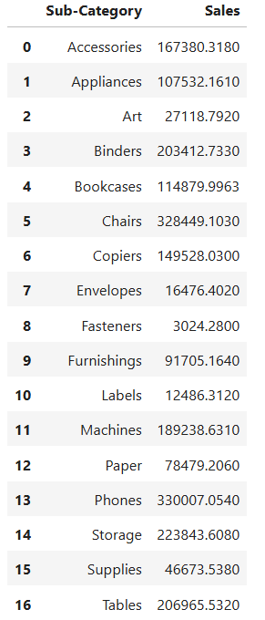
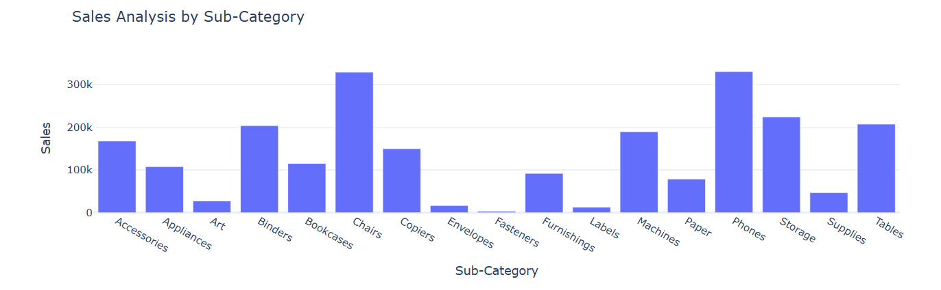
Q3. Sales Analysis by Sub-Category

Slide 7
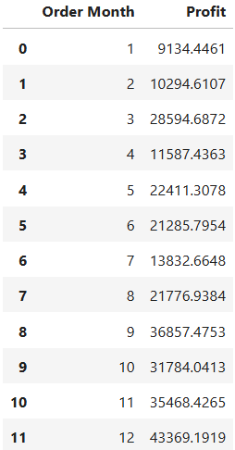
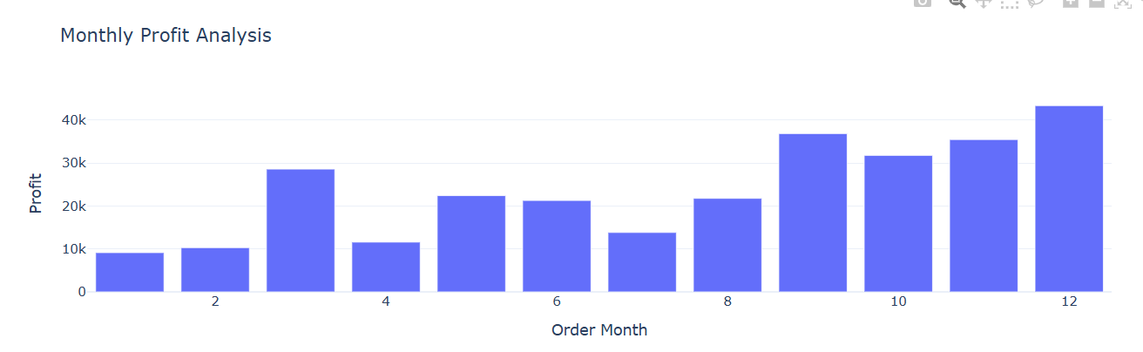
Q4. Monthly Profit Analysis

Slide 8
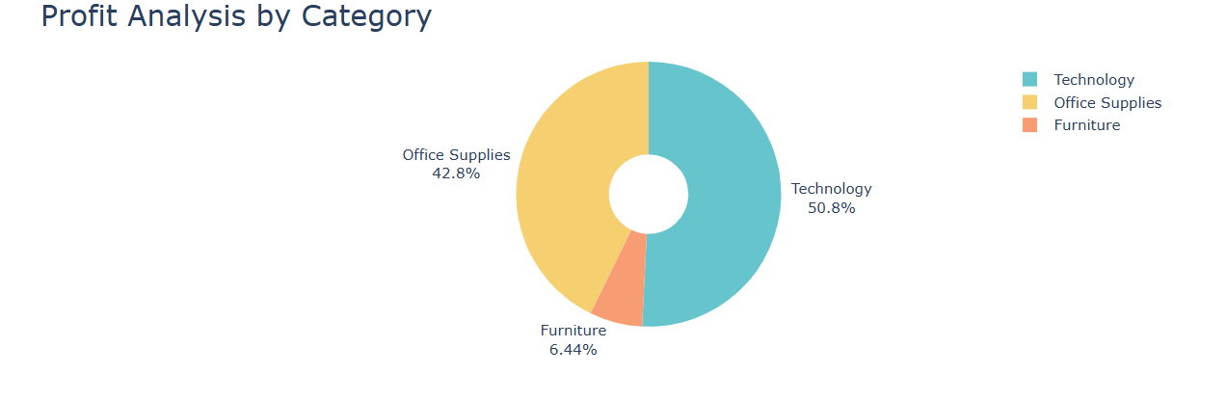
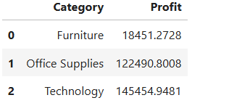
Q5. Profit Analysis by Category

Slide 9
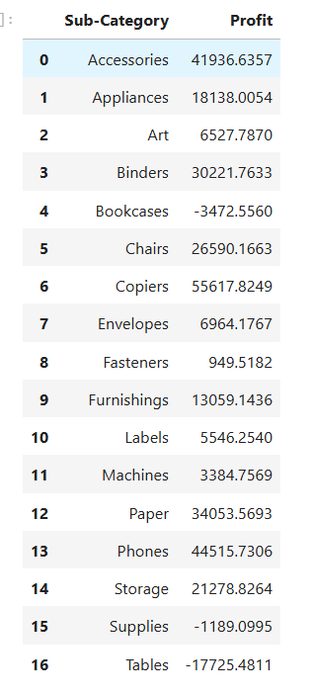
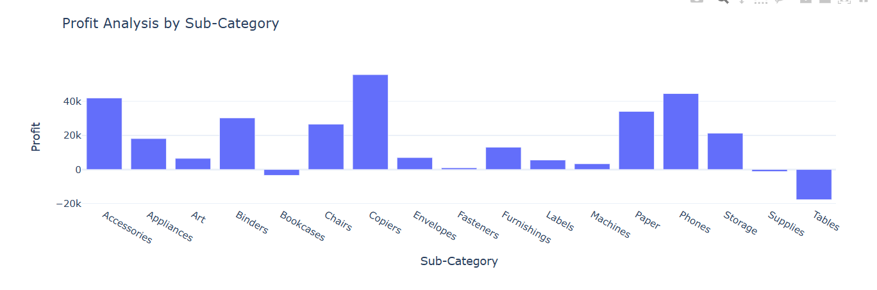
Q6. Profit Analysis by Sub-Category

Slide 10
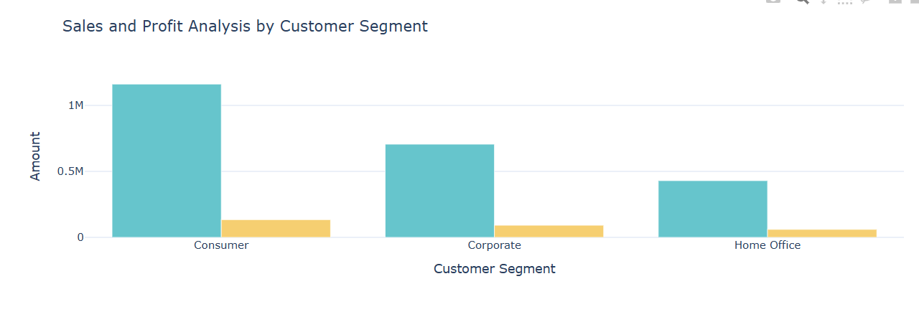
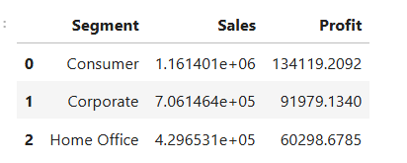
Q7. Sales and Profit Analysis by Customer Segment

Slide 11
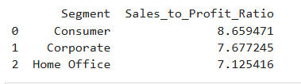
Q8. Sales to Profit Ratio

Slide 12
Key Insights
1
Technology (36.4%) contributes the highest to sales, followed by Furniture (32.3%) and Office Supplies
Despite its high sales, Furniture contributes minimally to profits compared to Technology and Office Supplies%).
2
Copiers show the highest profit among all sub-categories, followed by Phones and Chairs
Tables and Bookcases are major loss-making sub-categories, with Tables showing the most significant losses
3
December has the highest profit, indicating strong year-end performance
Mid-year (June-July) profits are significantly lower, highlighting a seasonal drop.
Consumers are the largest contributors to both sales and profit
The Home Office segment lags far behind in both metrics, presenting an opportunity for improvement
4
Sales steadily rise toward the end of the year, with December being the peak month.
February and April see notable spikes compared to surrounding months, suggesting successful campaigns or increased demand during these periods.
5

Slide 13





Strategic Recommendations
Focus on Copiers, Phones, and Chairs, which are top profit drivers.
Invest in promotional campaigns for these products to maintain their momentum.
.
Evaluate pricing, sourcing, and demand for Tables and Bookcases to reduce losses.
Consider discontinuing low-demand product lines or bundling them with high-performing products.
Launch aggressive marketing campaigns in December and April, leveraging peak demand
.
Design specific marketing campaigns for the Home Office segment, such as discounts for small
Businesses or personalized product bundles.
Increase stock levels for Copiers, Phones, and Chairs to meet demand spikes.

Slide 14

Thank You

